Slide 1


EmPhAsIS Empowering Pharmacists in Asthma management through Interactive SMS
Information and Training Webinar
emphasis.core.ubc.ca

Slide 2
Webinar Outline
Why asthma and adherence?
Why community pharmacists?
What is EmPhAsIS?
Step-by-step guide to being an EmPhAsIS site
Baseline procedures
Follow-up procedures (for Intervention Group)
Study-end procedures

Slide 3
EmPhAsIS Empowering Pharmacists in Asthma management through Interactive SMS
I. Asthma and Adherence

Slide 4
Why Asthma?
‘Adherence is a big problem in asthma’
Adherence to asthma controller therapies
-30 – 70% (In BC: 34%)
Improving adherence can prevent asthma-related:
Doctor visits (~9M/yr)
Emergency visits (~4 M/yr)
Hospitalizations (~1 M/yr)

Slide 5
Why Asthma?
‘Adherence is a big problem in asthma’
Adherence to asthma controller therapies
-30 – 70% (In BC: 34%)
Improving adherence can prevent asthma-related:
Doctor visits (~9M/yr)
Emergency visits (~4 M/yr)
Hospitalizations (~1 M/yr)

Slide 6

Adherence Key to Asthma Control
Asthma doesn’t have to control patients’ lives. Patients can control asthma by
Becoming educated about asthma
Taking medications as directed (‘adherence’)

Slide 7
EmPhAsIS Empowering Pharmacists in Asthma management through Interactive SMS
II. Community Pharmacists

Slide 8

Pharmacy in Canada
“
‘pharmacists are taking on expanded roles’
‘pharmacists are increasingly being recognized as the medication management experts’
‘pharmacists are key to ensuring safe, cost-effective drug therapy for Canadians’

Slide 9
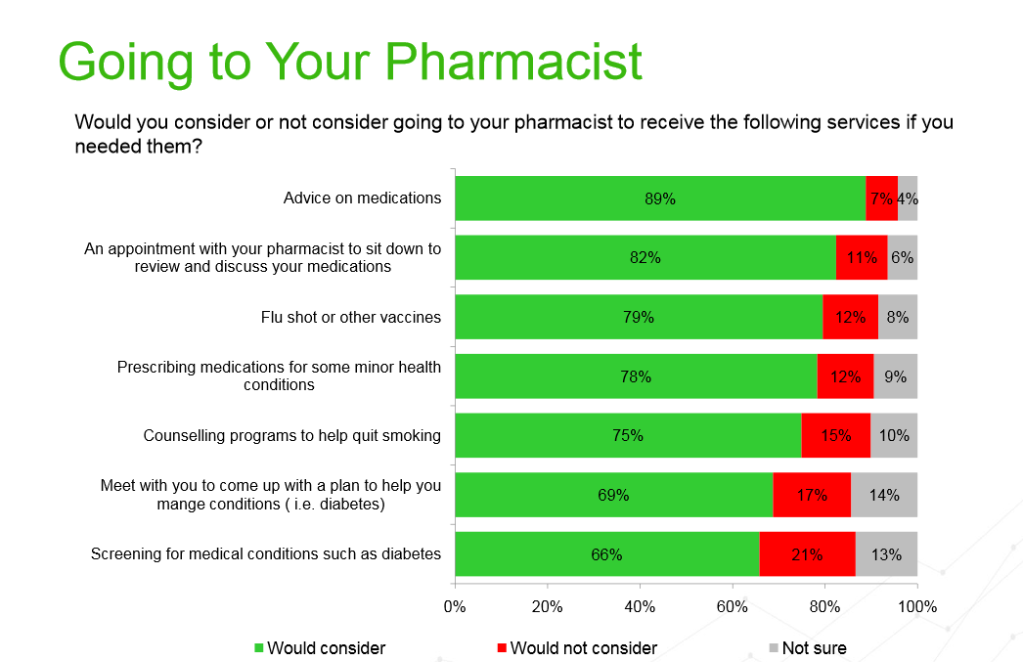

Slide 11
Pharmacy Practice Research
Studies that evaluate pharmacists’ roles in a variety of capacities including:
Systems research
Patient-centered research
Community based research
Strongly advocated by CPhA

Slide 12
Pharmacy Practice Research with UBC
From >10 years working with >100 pharmacies, you will:
Be provided training
Be provided tools as a study site
Have support from our Research Team
Have opportunity to provide feedback
….Have fun and contribute to evidence generation for expanded pharmacy scope in Canada

Slide 13
EmPhAsIS Empowering Pharmacists in Asthma management through Interactive SMS
III. What is EmPhAsIS?
Study of a community-pharmacist led adherence intervention for asthma

Slide 14



The Intervention
Asthma patient filling prescription for ICS
1. Pharmacist education about asthma
month 0 (Baseline)

Slide 15
The Intervention
Supported by
WelTel Platform
Asthma patient filling prescription for ICS
1. Pharmacist education about asthma
adherent
month 0 (Baseline)
adherent
2. Automated monthly assessment of adherence (and possible barriers) with SMS (text messages) centralized at UBC using WelTel platform
Schedule
First Monday of every month
month 1
month 2

Slide 16
The Intervention
Supported by
WelTel Platform
Asthma patient filling prescription for ICS
1. Pharmacist education about asthma
adherent
month 0 (Baseline)
adherent
2. Automated monthly assessment of adherence (and possible barriers) with SMS (text messages) centralized at UBC using WelTel platform
Schedule
First Monday of every month
month 1
not adherent
month 2
3. Follow-up phone call from pharmacist with non-adherent patients
month 3

Slide 17
The Intervention
Supported by
WelTel Platform
Asthma patient filling prescription for ICS
1. Pharmacist education about asthma
adherent
month 0 (Baseline)
adherent
2. Automated monthly assessment of adherence (and possible barriers) with SMS (text messages) centralized at UBC using WelTel platform
Schedule
First Monday of every month
month 1
not adherent
month 2
3. Follow-up phone call from pharmacist with non-adherent patients
month 3
month 12

Slide 18
The Intervention
Supported by
WelTel Platform
Asthma patient filling prescription for ICS
1. Pharmacist education about asthma
adherent
month 0 (Baseline)
adherent
2. Automated monthly assessment of adherence (and possible barriers) with SMS (text messages) centralized at UBC using WelTel platform
Schedule
First Monday of every month
month 1
not adherent
month 2
3. Follow-up phone call from pharmacist with non-adherent patients
month 3
* Innovation *
Supporting pharmacy practice with simple, widely used technology (eHealth)
month 12

Slide 19
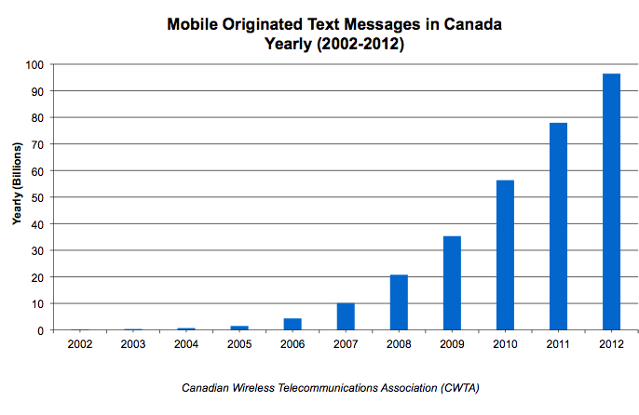
eHealth Supporting Pharmacy Practice
‘Cell phones are everywhere’
2014: 28.3 M Canadian mobile phone users
‘Canadians love to text’
96.5B texts
or
~250 M texts/day

Slide 20
eHealth Supporting Pharmacy Practice
‘Cell phones are everywhere’
2014: 28.3 M Canadian mobile phone users
‘Canadians love to text’
96.5B texts
or
~250 M texts/day

Slide 21


The Study
Partner with community pharmacies across BC
Conduct a pragmatic (‘real-world’) cluster randomized controlled trial (RCT)
+
intervention
usual care
+
+
+
+
+
+
Supported by
WelTel Platform
+

Slide 22
Study Groups in a Cluster RCT
In this study, pharmacies are randomized to study groups (and not patients)
Efficient
Reduces contamination
A randomization list was generated prior and study group assignments for consecutive site pharmacies are drawn from this list

Slide 23

‘P’eople Make EmPhAsIS Possible
Pharmacies across BC
Pharmacies (Pharmacy team)
randomly assigned to
+
40 Intervention
40 Usual Care
8 target patients
8 target patients
Patients
2 “Study Groups”

Slide 24
Study Groups
+
Pharmacies
Recruit, screen, enroll patients
Patients (Receive)
Intervention
Follow-up from research team
$25 honorarium at study end
Pharmacies
Recruit, screen, enroll patients
Patients (Receive)
Usual care
Follow-up from research team
$25 honorarium at study end
Automated monthly text messages to assess adherence for 12 months (after the study is complete)
Intervention
Provide asthma education
Check responses to monthly text messages from patients
Telephone follow-up with non-adherent patients
Usual Care
Provide asthma education
Supported by
WelTel Platform

Slide 25
Study Groups
+
Pharmacies
Recruit, screen, enroll patients
Patients (Receive)
Intervention
Follow-up from research team
$25 honorarium at study end
Pharmacies
Recruit, screen, enroll patients
Patients (Receive)
Usual care
Follow-up from research team
$25 honorarium at study end
Automated monthly text messages to assess adherence for 12 months (after the study is complete)
Intervention
Provide asthma education
Check responses to monthly text messages from patients
Telephone follow-up with non-adherent patients
Usual Care
Provide asthma education
Supported by
WelTel Platform

Slide 26
Study Groups
+
Pharmacies
Recruit, screen, enroll patients
Patients (Receive)
Intervention
Follow-up from research team
$25 honorarium at study end
Pharmacies
Recruit, screen, enroll patients
Patients (Receive)
Usual care
Follow-up from research team
$25 honorarium at study end
Automated monthly text messages to assess adherence for 12 months (after the study is complete)
Intervention
Provide asthma education
Check responses to monthly text messages from patients
Telephone follow-up with non-adherent patients
Usual Care
Provide asthma education
Supported by
WelTel Platform

Slide 27
Study Groups
+
Pharmacies
Recruit, screen, enroll patients
Patients (Receive)
Intervention
Follow-up from research team
$25 honorarium at study end
Pharmacies
Recruit, screen, enroll patients
Patients (Receive)
Usual care
Follow-up from research team
$25 honorarium at study end
Automated monthly text messages to assess adherence for 12 months (after the study is complete)
Intervention
Provide asthma education
Check responses to monthly text messages from patients
Telephone follow-up with non-adherent patients
Usual Care
Provide asthma education
Supported by
WelTel Platform

Slide 28
Study Groups
+
Pharmacies
Recruit, screen, enroll patients
Patients (Receive)
Intervention
Follow-up from research team
$25 honorarium at study end
Pharmacies
Recruit, screen, enroll patients
Patients (Receive)
Usual care
Follow-up from research team
$25 honorarium at study end
Automated monthly text messages to assess adherence for 12 months (after the study is complete)
Intervention
Provide asthma education
Check responses to monthly text messages from patients
Telephone follow-up with non-adherent patients
Usual Care
Provide asthma education
Supported by
WelTel Platform

Slide 29
Study Groups
+
Pharmacies
Recruit, screen, enroll patients
Patients (Receive)
Intervention
Follow-up from research team
$25 honorarium at study end
Pharmacies
Recruit, screen, enroll patients
Patients (Receive)
Usual care
Follow-up from research team
$25 honorarium at study end
Automated monthly text messages to assess adherence for 12 months (after the study is complete)
Intervention
Provide asthma education
Check responses to monthly text messages from patients
Telephone follow-up with non-adherent patients
Usual Care
Provide asthma education
Supported by
WelTel Platform

Slide 30
Study Groups
+
Pharmacies
Recruit, screen, enroll patients
Patients (Receive)
Intervention
Follow-up from research team
$25 honorarium at study end
Pharmacies
Recruit, screen, enroll patients
Patients (Receive)
Usual care
Follow-up from research team
$25 honorarium at study end
Automated monthly text messages to assess adherence for 12 months (after the study is complete)
Intervention
Provide asthma education
Check responses to monthly text messages from patients
Telephone follow-up with non-adherent patients
Usual Care
Provide asthma education
Supported by
WelTel Platform

Slide 31
EmPhAsIS Empowering Pharmacists in Asthma management through Interactive SMS
IV. Conducting EmPhAsIS in your Pharmacy
Resources and Baseline Procedures

Slide 32
Resource 1: Binder
+
Important information contained
Site #
3-digit ‘pharmacy ID’ (i.e. 007)
Unique to your pharmacy
Randomization status (intervention or usual care)
Patient Study IDs (sheets of labels)
Unique to each patient that you will enroll
Tools to conduct the study in your pharmacy

Slide 33
Resource 1: Binder
+
Important information contained
Site #
3-digit ‘pharmacy ID’ (i.e. 007)
Unique to your pharmacy
Randomization status (intervention or usual care)
Patient Study IDs (sheets of labels)
Unique to each patient that you will enroll
Tools to conduct the study in your pharmacy

Slide 34
All About Your Site #
+
Makes up part of your username to allow access to all electronic resources
Pharmacists section in EmPhAsIS website
For Intervention and Usual Care Groups
WelTel platform
For Intervention Group only
Same username for both resources
username = phar### (i.e. phar007)

Slide 35
All About Your Site #
+
Makes up part of your username to allow access to all electronic resources
Pharmacists section in EmPhAsIS website
For Intervention and Usual Care Groups
WelTel platform
For Intervention Group only
Same username for both resources
username = phar### (i.e. phar007)

Slide 36

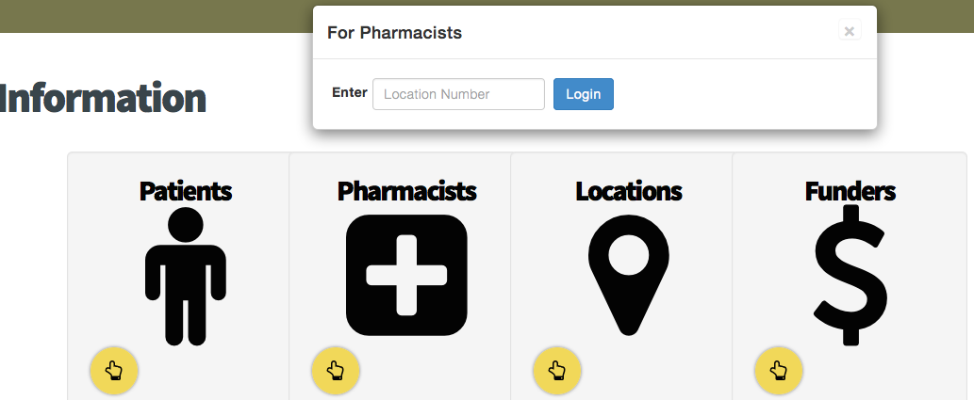
Resource 2: Website
+
Click on “INFO” to access Pharmacists Section
2. Enter username (i.e. phar007)

Slide 37
Resource 2: Website
+
Click on “INFO” to access Pharmacists Section
2. Enter username (i.e. phar007)

Slide 38
Resource 3: WelTel Platform
+
For Intervention Group only, use to:
Register patients for automated monthly texts
Check responses to monthly texts from patients
Manage follow-ups with non-adherent patients

Slide 39
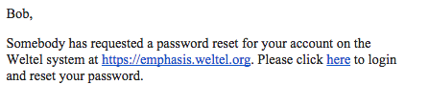
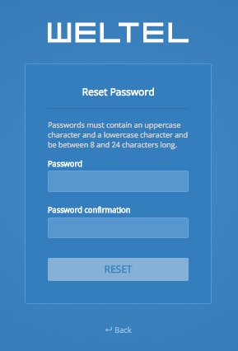
Creating your WelTel Password
+
After training, you will receive an email to “reset” your WelTel password
Create password
You are now ready
to register patients
into the platform
Will lead you to this screen
No username required at this stage

Slide 40
Creating your WelTel Password
+
After training, you will receive an email to “reset” your WelTel password
Create password
You are now ready
to register patients
into the platform
Will lead you to this screen
No username required at this stage

Slide 41
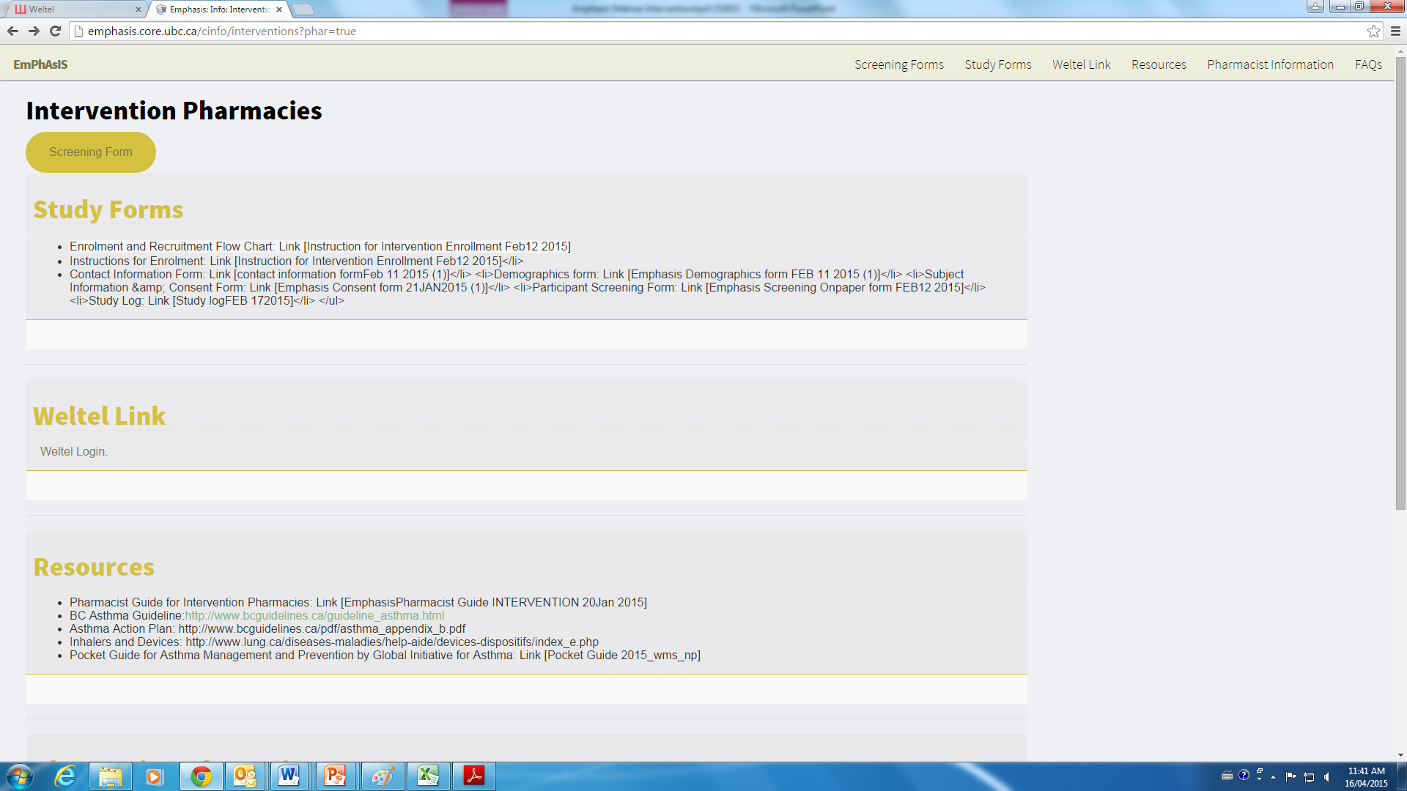
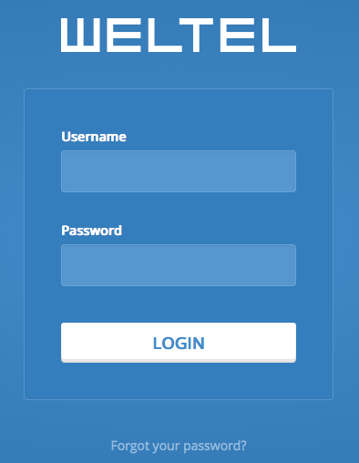
Accessing WelTel Platform
+
Go to “Pharmacists” section in EmPhAsIS website
Enter your username + created password
Your username (i.e. phar007)
Your created password

Slide 42
Accessing WelTel Platform
+
Go to “Pharmacists” section in EmPhAsIS website
Enter your username + created password
Your username (i.e. phar007)
Your created password

Slide 43
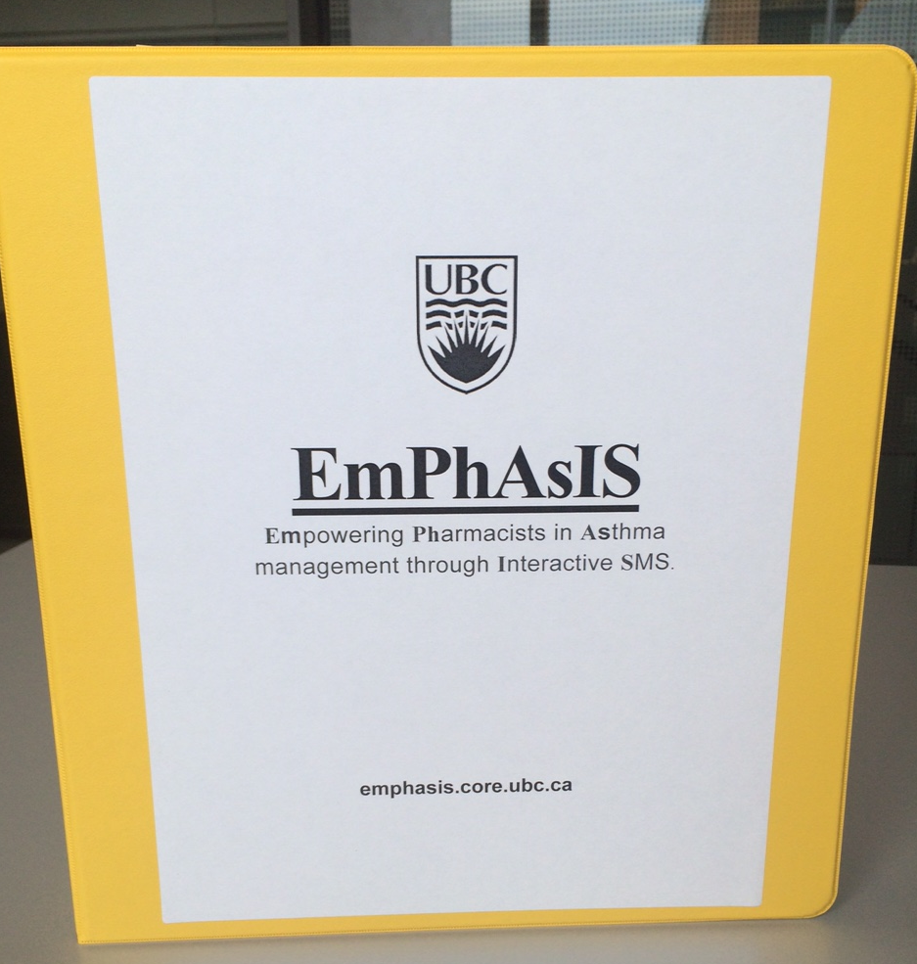
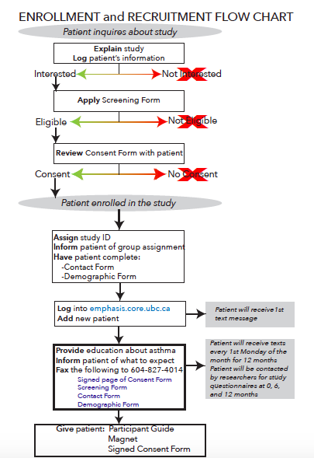
Baseline EmPhAsIS Procedures
+
Recruit (Explain study to patients)
Screen (Patients for eligibility)
Consent (Eligible patients)
Complete Enrolment Procedures (Related to Intervention or Usual Care)
In your binder
Enrollment and Recruitment Flow Chart (laminated)

Slide 44

Eligibility Criteria for Patients
+
3. Prescribed with inhaled corticosteroids
2. Diagnosed with asthma
4.Have a cell phone with text capabilities
1. 14 years or older

Slide 45
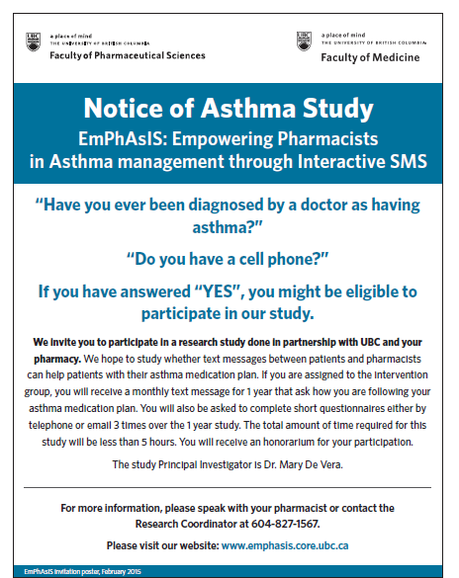
1. Recruit
+
In your binder
Study Ad (colour & BW)
Tip
Post ad on:
Wall by counseling area
Counter
Recruit
Screen
Consent
Complete Enrolment

Slide 46
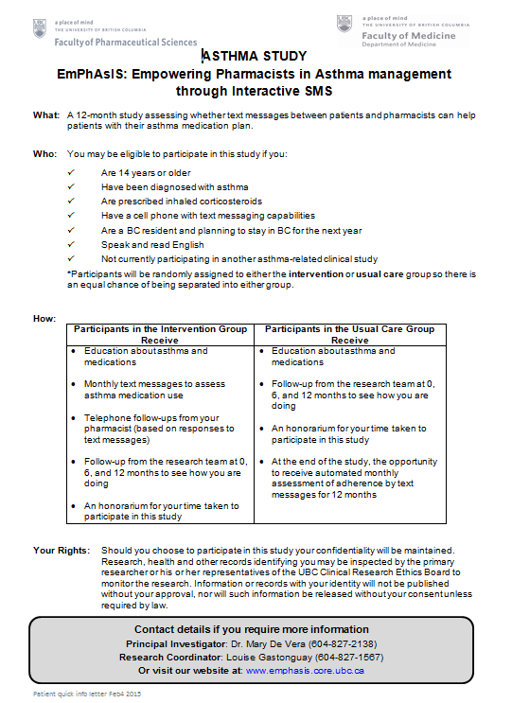
1. Recruit
+
In your binder
Patient Quick Info Letter
Tip
Use to explain EmPhAsIS study to patients
Hand out to asthma patients
Recruit
Screen
Consent
Complete Enrolment

Slide 47
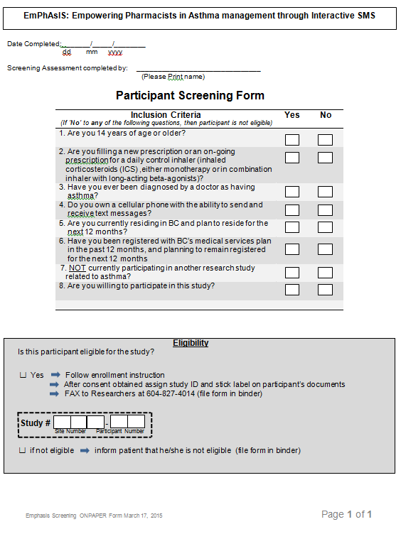
2. Screen for Eligibility
+
In your binder
Participant Screening Form
Via website
Online Participant Screening Form
Recruit
Screen
Consent
Complete Enrolment

Slide 48
2. Screen for Eligibility
+
In your binder
Participant Screening Form
Via website
Online Participant Screening Form
Recruit
Screen
Consent
Complete Enrolment

Slide 49
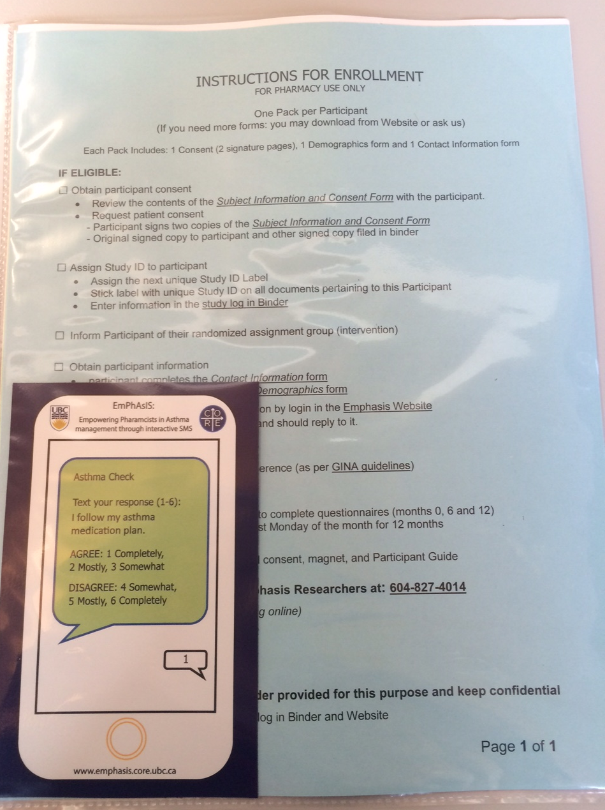
3. Consent Eligible Patients
+
In your binder
10 Enrolment Packages (in plastic covers)
Instructions
Subject Information and Consent Form
Contact Form
Demographic Form
Participant Guide
[Magnet - Intervention Group only]
Use 1 package per eligible patient
Recruit
Screen
Consent
Complete Enrolment

Slide 50
3. Consent Eligible Patients
+
Important part of enrollment process
Review Subject Information and Consent Form with patient
Have patient sign the 2 copies of page 9
1 copy stapled to form → Patient takes home
1 copy not stapled → Fax to UBC and File in binder
It is after patient has signed that you may inform of his/her study group assignment
Recruit
Screen
Consent
Complete Enrolment

Slide 51
3. Consent Eligible Patients
+
Important part of enrollment process
Review Subject Information and Consent Form with patient
Have patient sign the 2 copies of page 9
1 copy stapled to form → Patient takes home
1 copy not stapled → Fax to UBC and File in binder
It is after patient has signed that you may inform of his/her study group assignment
Recruit
Screen
Consent
Complete Enrolment

Slide 52
3. Consent Eligible Patients
+
Important part of enrollment process
Review Subject Information and Consent Form with patient
Have patient sign the 2 copies of page 9
1 copy stapled to form → Patient takes home
1 copy not stapled → Fax to UBC and File in binder
It is after patient has signed that you may inform of his/her study group assignment
Recruit
Screen
Consent
Complete Enrolment

Slide 53
4. Complete Enrolment
+
Have patient complete
Contact Form
Demographic Form
Fax to UBC 604-827-4014 and File in your binder (“Completed Forms” tab)
Recruit
Screen
Consent
Complete Enrolment

Slide 54
4. Complete Enrolment (By Group)
Pharmacies
Recruit, screen, enroll patients
Patients (Receive)
Intervention
Follow-up from research team
$25 honorarium
Pharmacies
Recruit, screen, enroll patients
Patients (Receive)
Usual care
Follow-up from research team
$25 honorarium
Automated monthly text messages to assess adherence for 12 months (after the study is complete)
Intervention
Provide asthma education
Check responses to monthly text messages from patients
Telephone follow-up with non-adherent patients
Usual Care
Provide asthma education
Supported by
WelTel Platform
Recruit
Screen
Consent
Complete Enrolment

Slide 55
4. Providing Asthma Education
+
Both Intervention and Usual Care Pharmacies:
As this is a real-world (‘pragmatic’) clinical trial, provide education according to your own practice
Educational resources on asthma available website for both patients and pharmacists
Recruit
Screen
Consent
Complete Enrolment

Slide 56
4. Initiating Text Messages
+
Intervention Group Pharmacies Only
Access WelTel Platform via website
Recruit
Screen
Consent
Complete Enrolment

Slide 57
4. Initiating Text Messages
+
Intervention Group Pharmacies Only
Login into WelTel platform (via ‘Pharmacists’ section of EmPhAsIS website)
Your username
(i.e. phar007)
Your created password
Recruit
Screen
Consent
Complete Enrolment

Slide 58
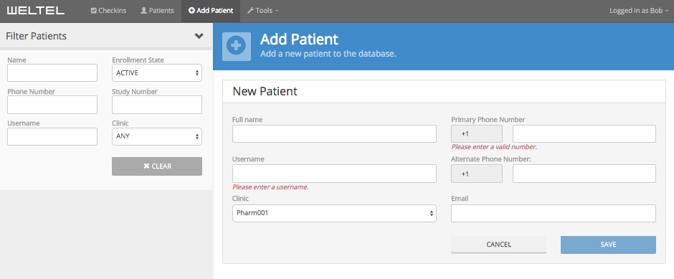
4. Initiating Text Messages
+
1. Click on Add Patient
4. Must be a cell phone number
2. Enter full name
3. Enter Patient Study ID
5. Click on ‘Save’ after completing the required fields
6. Patient will receive first text message within a few seconds/minutes
Recruit
Screen
Consent
Complete Enrolment

Slide 59
4. Complete Enrolment
+
Provide patient with:
Plastic package containing
Signed Subject Information & Consent Form
Participant Guide
Magnet (for Intervention Group)
Inform patient that:
Research team will follow-up within 48 hours
S/he will receive text messages on the first Monday of every month for 12 months (for Intervention Group)
Recruit
Screen
Consent
Complete Enrolment

Slide 60
4. Complete Enrolment
+
Provide patient with:
Plastic package containing
Signed Subject Information & Consent Form
Participant Guide
Magnet (for Intervention Group)
Inform patient that:
Research team will follow-up within 48 hours
S/he will receive text messages on the first Monday of every month for 12 months (for Intervention Group)
Recruit
Screen
Consent
Complete Enrolment

Slide 61
4. Complete Enrolment
+
Reminder to Fax to UBC 604-827-4014 and File in your binder (“Completed Forms” tab) the following:
Participant Screening Form
Signed Subject Information & Consent Form (page 9)
Contact Form
Demographic Form
Update the Study Log
Found at the front of your binder
Recruit
Screen
Consent
Complete Enrolment

Slide 62
4. Complete Enrolment
+
Reminder to Fax to UBC 604-827-4014 and File in your binder (“Completed Forms” tab) the following:
Participant Screening Form
Signed Subject Information & Consent Form (page 9)
Contact Form
Demographic Form
Update the Study Log
Found at the front of your binder
Recruit
Screen
Consent
Complete Enrolment

Slide 63
Additional Resources
+
Please view mini-webinars
Baseline Procedures: Recruiting and Screening Patients
Baseline Procedures: Consenting and Enrolling Patients
Baseline Procedures: Usual Care Pharmacy, Next Steps
Baseline Procedures: Intervention Pharmacy, Next Steps
Please refer to Pharmacist Guide (in your binder)
Intervention and Usual Care Versions available
Recruit
Screen
Consent
Complete Enrolment

Slide 64
EmPhAsIS Empowering Pharmacists in Asthma management through Interactive SMS
V. Conducting EmPhAsIS in your Pharmacy
Follow-up Procedures
(Required for Intervention Group Pharmacies; For Information Only for Usual Care Pharmacies)

Slide 65
The Intervention
+
Supported by
WelTel Platform
Asthma patient filling prescription for ICS
1. Pharmacist education about asthma
adherent
month 0 (Baseline)
adherent
2. Automated monthly assessment of adherence (and possible barriers) with SMS (text messages) centralized at UBC using WelTel platform
Schedule
First Monday of every month
month 1
not adherent
month 2
3. Follow-up phone call from pharmacist with non-adherent patients
month 3
month 12

Slide 66
Automation of Monthly SMS
+
WelTel Platform
You do not have to send texts to patients
For duration of study, only available to Intervention Group pharmacies
Your username
(i.e. phar007)
Your created password

Slide 67
Understanding EmPhAsIS SMS
+
SMS comprises
Adult Asthma Adherence Questionnaire (AAAQ) used to screen adherence problem and barriers in asthma patients
Every Month: Question 1 (sent on first Monday) to assess adherence problem
Based on Response to Question 1: Questions 2 to 5 to identify potential barriers to adherence
Txt 1-6 for: I follow my asthma medication plan.
AGREE:
Completely=1;
Mostly=2, Somewhat=3;
DISAGREE:
Somewhat=4;
Mostly=5, Completely=6
Notes:
For the script: Introduce AAAQ

Slide 68
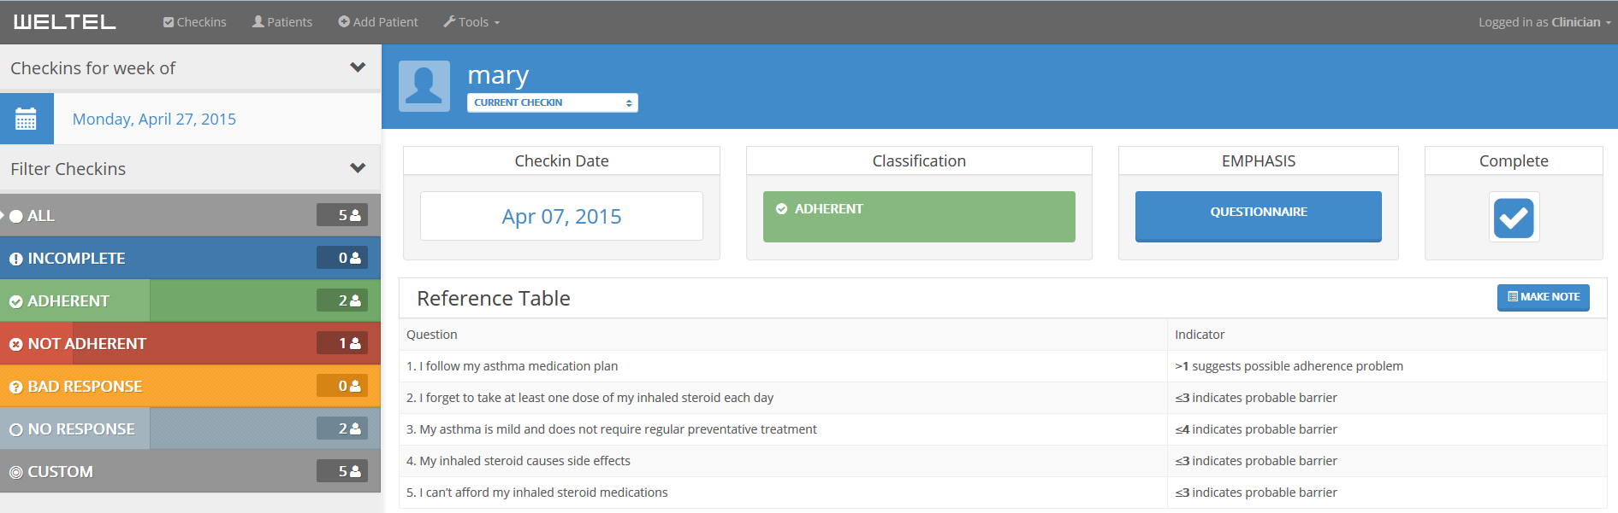
AAAQ Reference Table in WelTel
+
assess adherence problem
identify adherence barrier
managing ICS use
perceived need for ICS
fear of side effects
cost concerns

Slide 69
AAAQ Reference Table in WelTel
+
assess adherence problem
identify adherence barrier
managing ICS use
perceived need for ICS
fear of side effects
cost concerns

Slide 70
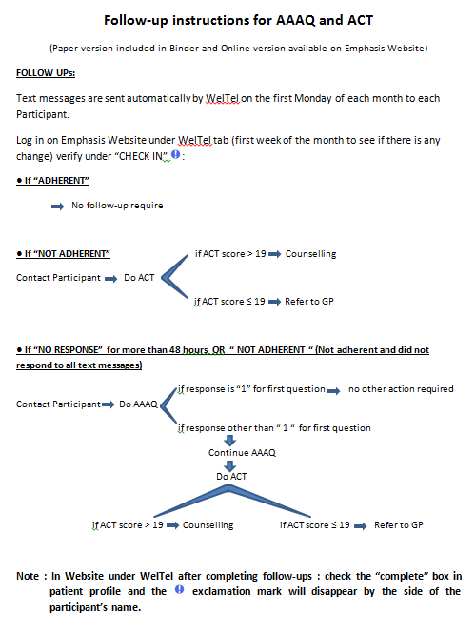
Follow-up EmPhAsIS Procedures
+
Check monthly SMS (“checkin”) (Patient responses to monthly SMS in WelTel platform)
Follow-up non-adherent patients by telephone (if needed)
In your binder
Follow-up Instructions for AAAQ and ACT (laminated)

Slide 71
1. Checkins
+
Standardized sending of text messages on the first Monday of every month via WelTel
You will not have to do anything with respect to texting participant yourself
Tip:
Incorporate monthly SMS checks into workflow by doing “checkins” on WelTel on first Tuesday (or first Wednesday) of the month
Check monthly SMS
Follow-up non-adherent patients

Slide 72
1. Checkins
+
Standardized sending of text messages on the first Monday of every month via WelTel
You will not have to do anything with respect to texting participant yourself
Tip:
Incorporate monthly SMS checks into workflow by doing “checkins” on WelTel on first Tuesday (or first Wednesday) of the month
Check monthly SMS
Follow-up non-adherent patients

Slide 73
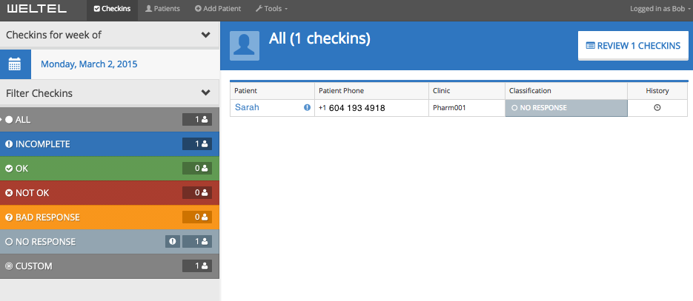



1. Checkins
+
‘Checkins’ view for all patients (# according to Status)
Green = # of ADHERENT checkins
Red = # of NOT ADHERENT checkins
Gray = # checkins with NO RESPONSE
Check monthly SMS
Follow-up non-adherent patients

Slide 74
1. Checkins
+
‘Checkins’ view for all patients (List)
Symbol indicates ‘checkins’ needing review
Click on symbol to check new message
Click on patient’s name to view profile and SMS history
Check monthly SMS
Follow-up non-adherent patients

Slide 75
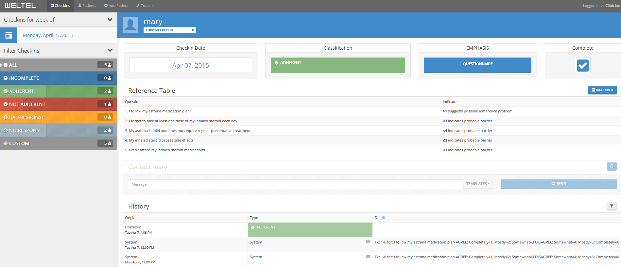
1. Checkins
+
Profile view for individual patient
1. Checkin status
4. Complete box indicates monthly checkin was completed and reviewed by you
(Tip: Important to check this for NOT ADHERENT patients)
3. Access to AAAQ or ACT
2. SMS send and response History
(Tip: “Read up”, earlier text on bottom)
Check monthly SMS
Follow-up non-adherent patients

Slide 76
1. Checkins
+
Profile view for individual patient
1. Checkin status
4. Complete box indicates monthly checkin was completed and reviewed by you
(Tip: Important to check this for NOT ADHERENT patients)
3. Access to AAAQ or ACT
2. SMS send and response History
(Tip: “Read up”, earlier text on bottom)
Check monthly SMS
Follow-up non-adherent patients

Slide 77
2. Follow-up Non-Adherent Patients
+
Your role in this step is the most important part of the EmPhAsIS study
Because this is a pragmatic study, please provide counselling according to your practice but we have provided you with some tools to help
Tools
AAAQ Questions 2 to 5 to identify adherence barrier
Texted to patients OR
Accessible via WelTel OR
AAAQ Form (in binder)
Asthma Control Test (ACT) to assess asthma control
Accessible via WelTel OR
ACT Form (in binder)
Check monthly SMS
Follow-up non-adherent patients

Slide 78
2. Follow-up Non-Adherent Patients
+
Your role in this step is the most important part of the EmPhAsIS study
Because this is a pragmatic study, please provide counselling according to your practice but we have provided you with some tools to help
Tools
AAAQ Questions 2 to 5 to identify adherence barrier
Texted to patients OR
Accessible via WelTel OR
AAAQ Form (in binder)
Asthma Control Test (ACT) to assess asthma control
Accessible via WelTel OR
ACT Form (in binder)
Check monthly SMS
Follow-up non-adherent patients

Slide 79
2. Follow-up Non-Adherent Patients
+
Your role in this step is the most important part of the EmPhAsIS study
Because this is a pragmatic study, please provide counselling according to your practice but we have provided you with some tools to help
Tools
AAAQ Questions 2 to 5 to identify adherence barrier
Texted to patients OR
Accessible via WelTel OR
AAAQ Form (in binder)
Asthma Control Test (ACT) to assess asthma control
Accessible via WelTel OR
ACT Form (in binder)
Check monthly SMS
Follow-up non-adherent patients

Slide 80
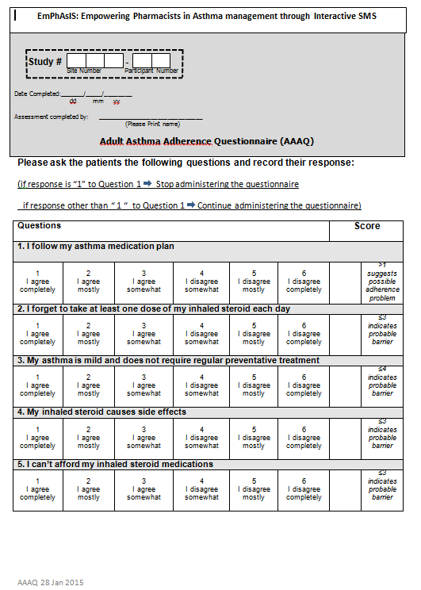
2. Follow-up Non-Adherent Patients
+
Why the AAAQ?
By identifying potential adherence barrier, we hope this tool will facilitate your counselling
Please note: This is provided as a tool and while we encourage its use, you may decide to use/not use
Check monthly SMS
Follow-up non-adherent patients

Slide 81
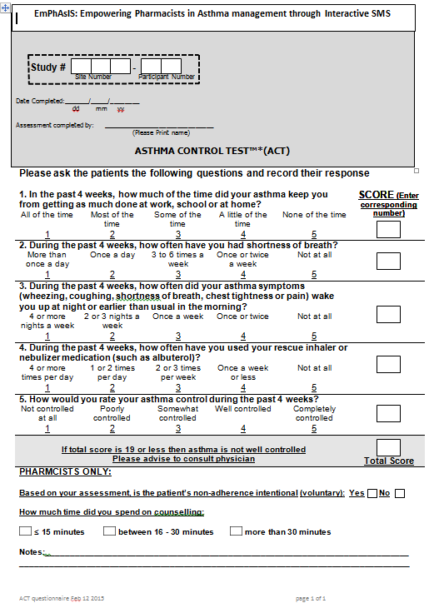
2. Follow-up Non-Adherent Patients
+
Why the ACT?
This allows assessment of asthma control
If total score is 19 or lower, please advise patient to consult their GP
Please note: This is provided as a tool and while we encourage its use, you may decide to use/not use
Check monthly SMS
Follow-up non-adherent patients

Slide 82
2. Follow-up Non-Adherent Patients
+
Why the ACT?
This allows assessment of asthma control
If total score is 19 or lower, please advise patient to consult their GP
Please note: This is provided as a tool and while we encourage its use, you may decide to use/not use
Check monthly SMS
Follow-up non-adherent patients

Slide 83
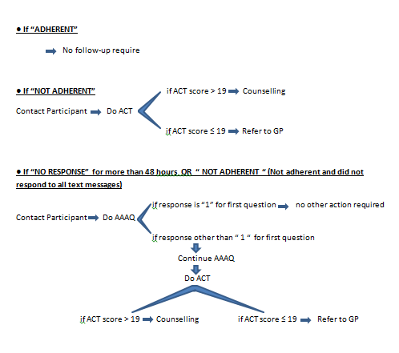
2. Follow-up Non-Adherent Patients
+
From Follow-up Instructions for AAAQ and ACT (laminated card), possible scenarios:
Check monthly SMS
Follow-up non-adherent patients

Slide 84
2. Follow-up Non-Adherent Patients
+
We understand pharmacies and pharmacists are busy and we encourage:
Two attempts (if possible) at contacting patients
If after two attempts, you are not able to contact the patient,
Please inform research team
Await responses to next month’s SMS
Check monthly SMS
Follow-up non-adherent patients

Slide 85
Additional Resources
+
Please view mini-webinar
Follow-up Procedures: Intervention Pharmacy Monthly Follow-up and WelTel Platform
Please refer to Pharmacist Guide (in your binder)
For Intervention Group
Check monthly SMS
Follow-up non-adherent patients

Slide 86
EmPhAsIS Empowering Pharmacists in Asthma management through Interactive SMS
VI. Conducting EmPhAsIS in your Pharmacy
Study End Procedures

Slide 87
Study End EmPhAsIS Procedures
+
Print participants’ medication profile
Arrange collection of study materials by research team
Offer opportunity to receive automated monthly assessment of adherence by text messages for 12 months to participants (for Usual Care Group only)

Slide 88
Study End EmPhAsIS Procedures
+
Print participants’ medication profile
Arrange collection of study materials by research team
Offer opportunity to receive automated monthly assessment of adherence by text messages for 12 months to participants (for Usual Care Group only)

Slide 89
1. Print Medication Profile
+
Once a participant has completed 12 months of follow-up in the study, you will be contacted by the research team to:
Print a medication profile that lists their medications over the 12 months
Fax the profile to UBC at 604-827-4014
Print Medication Profile
Collect Study Materials
Offer SMS Opportunity

Slide 90
2. Arrange Collection of Materials
+
Once all of the participants enrolled in your pharmacy have completed 12 months of follow-up in the study, you will be contacted by the research team to:
Make arrangements to collect study binders
By pickup if in Greater Vancouver Area
Secure post or courier services if outside Greater Vancouver Area
Print Medication Profile
Collect Study Materials
Offer SMS Opportunity

Slide 91
3. Offer SMS Opportunity
For Usual Care Pharmacies
You or patients you recruited may be interested in experiencing having automated monthly assessment of adherence by text messages (for 12 months)
If so, please contact us and we will gladly arrange this for you
Please note that this will be for automated text messages only, there will be no follow-up procedures with non-adherent patients
Print Medication Profile
Collect Study Materials
Offer SMS Opportunity

Slide 92
Before Launching EmPhAsIS
+
Inform your staff of your participation as an EmPhAsIS site
Have team (pharmacists, technicians, and students)
Complete Information and Training Webinar
Review Binder
Sign Training Signing Sheet found in your binder (Fax completed sheet to UBC, 604-827-4014)
Fax courtesy Physician Letter found in your binder to family physicians in your area to inform them about the study
Create a short-cut on your computer(s) to our website (http://emphasis.core.ubc.ca/) for instant access
For Intervention Groups, create your password for WelTel platform

Slide 93
Before Launching EmPhAsIS
+
Inform your staff of your participation as an EmPhAsIS site
Have team (pharmacists, technicians, and students)
Complete Information and Training Webinar
Review Binder
Sign Training Signing Sheet found in your binder (Fax completed sheet to UBC, 604-827-4014)
Fax courtesy Physician Letter found in your binder to family physicians in your area to inform them about the study
Create a short-cut on your computer(s) to our website (http://emphasis.core.ubc.ca/) for instant access
For Intervention Groups, create your password for WelTel platform

Slide 94
Before Launching EmPhAsIS
+
Inform your staff of your participation as an EmPhAsIS site
Have team (pharmacists, technicians, and students)
Complete Information and Training Webinar
Review Binder
Sign Training Signing Sheet found in your binder (Fax completed sheet to UBC, 604-827-4014)
Fax courtesy Physician Letter found in your binder to family physicians in your area to inform them about the study
Create a short-cut on your computer(s) to our website (http://emphasis.core.ubc.ca/) for instant access
For Intervention Groups, create your password for WelTel platform

Slide 95
Before Launching EmPhAsIS
+
Inform your staff of your participation as an EmPhAsIS site
Have team (pharmacists, technicians, and students)
Complete Information and Training Webinar
Review Binder
Sign Training Signing Sheet found in your binder (Fax completed sheet to UBC, 604-827-4014)
Fax courtesy Physician Letter found in your binder to family physicians in your area to inform them about the study
Create a short-cut on your computer(s) to our website (http://emphasis.core.ubc.ca/) for instant access
For Intervention Groups, create your password for WelTel platform

Slide 96
EmPhAsIS Empowering Pharmacists in Asthma management through Interactive SMS
Questions?
Please do not hesitate to contact us
Dr. Mary De Vera at 604-827-2138 (mdevera@mail.ubc.ca)
Research Coordinator (Louise) at 604-827-1567 (louisega@mail.ubc.ca)
Fax: 604-827-4014
Mailing Address
2405 Wesbrook Mall, Vancouver BC, Canada V6T 1Z3

